Slide 1
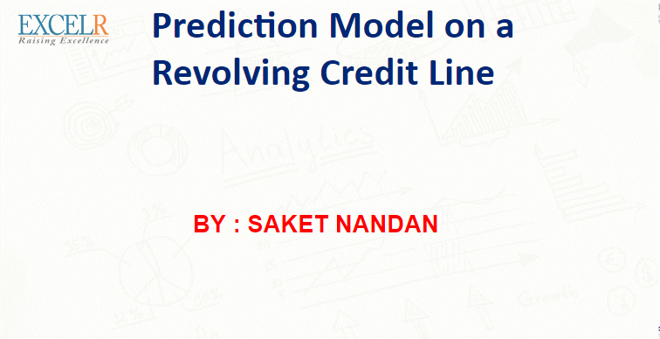

Slide 2

Business Problem:
Revolving Credit means you're borrowing against a Line of Credit.
Users can borrow the amount of credit allowed to use each month known as “Credit line or Credit Limit”.
Similar to a Credit card with the only difference being “Lesser Interest Rates and Secured Business Assets”.
At the end of each statement period, a Bill gets generated.
If not paid fully, the balance is carried over, or revolved over to the next month along with Interest incurred on the remaining balance.
As you pay down the balance, more of your credit line becomes available.
Objective:
“To predict the revolving balance maintained by each customer to derive market strategies for a bank or investment firm”.

Slide 3
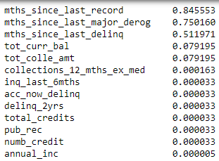

Exploratory Data Analysis (EDA)
Numerical Type
Categorical Type
MISSING
VALUES???
36 months in ‘terms’ column has 70% data compared to 60 months.
33% of the customers have over 10 years of Experience.
50% of ‘home_ownership’ have MORTGAGED while 40% of them are on RENT.
Almost 60% of loans taken cater the purpose of ‘debt_consolidation’.
15% (MAX) of customers are based out of California State while only 12 users(MIN) are from Idaho state.
80% of the customers DON’T HAVE delinquent accounts for a span of 2 years while 56% customers DON’T HAVE delinquent accounts since 6 months.
Almost 80% of ‘tot_colle_amt ‘(total collection amount ever owed) is ZERO dollars.
'mths_since_last_record‘ ,'mths_since_last_major_derog‘ and ‘verification_status_joint’ have LARGEST amount of missing values – 84%, 75% and 99.9% respectively.
‘annual_inc’, ‘debt_income_ratio’, ‘collection_recovery_fee’, ‘acc_now_delinq’ and ‘tot_colle_amt’ are HIGHLY SKEWED.
‘State’ and ‘last_week_pay’ have HIGH CARDINALITY.

Slide 4
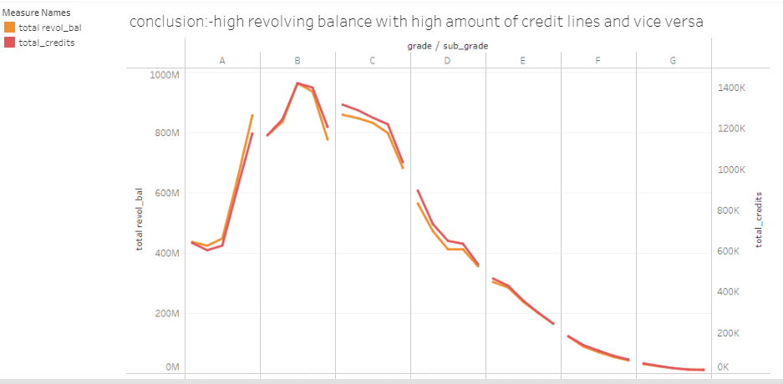
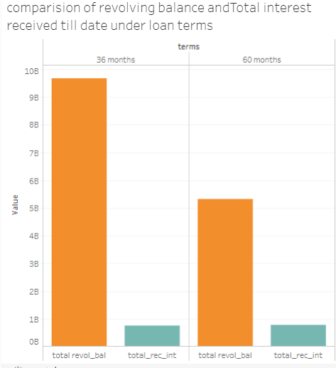
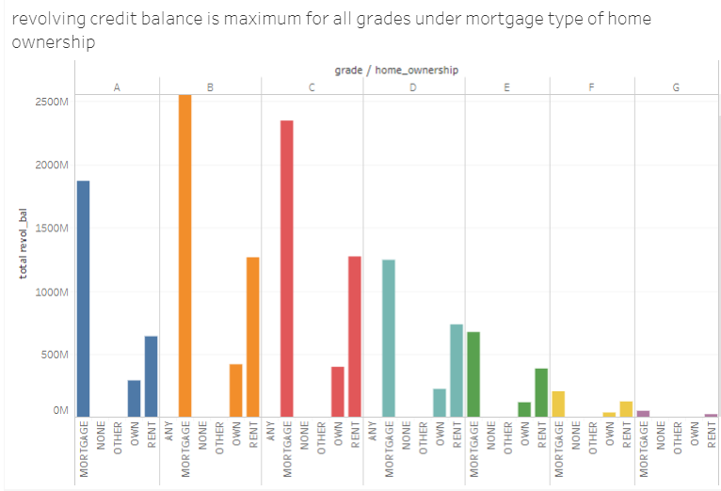
EDA( VISUALIZATION)

Slide 5
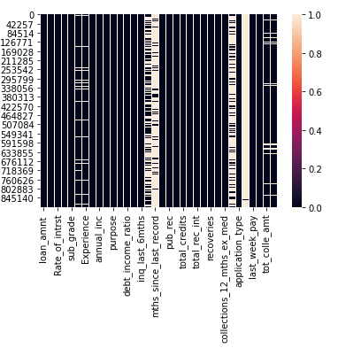
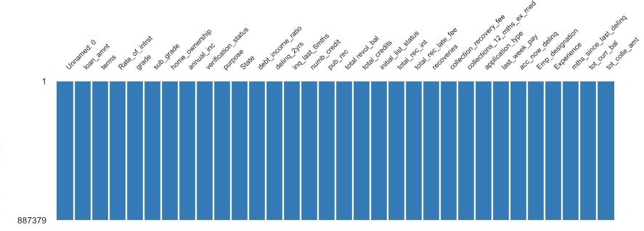
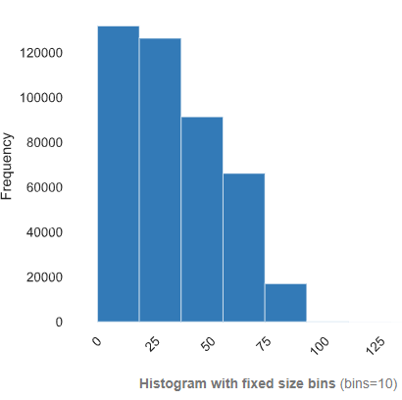
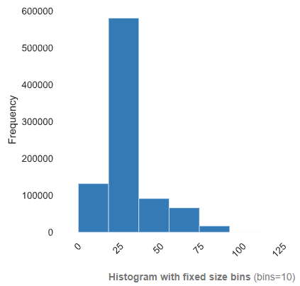
EDA( VISUALIZATION) Contd..
NULL VALUES
NO NULL VALUES
IMPUTATION

Slide 6
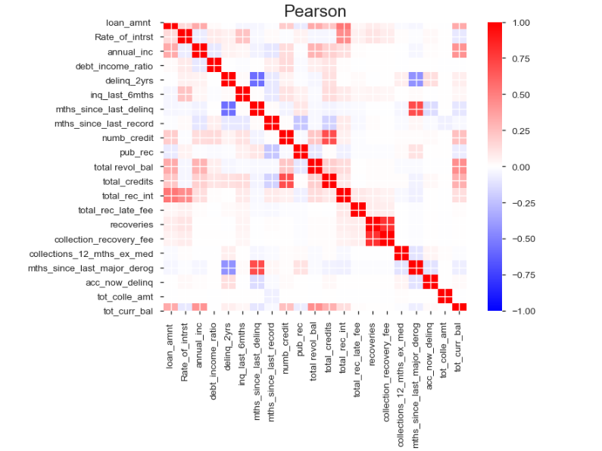
EDA( VISUALIZATION) Contd..
CORRELATION

Slide 7
Model Building

Slide 8
Model Building
Linear Regression
Dataset Type | Test Size | Random State | R-squared | RMSE
NULL | 0.3 | 0 | 0.261 | 18947.63
NOT NULL | 0.3 | 0 | 0.261 | 18851.73

Slide 9
Model Building
Random Forest
Data Type | Model Type | Test Size | Random State | R-squared (Train) | R-squared (Test) | RMSE (Train) | RMSE (Test)
NOT NULL | Only Numerical | 0.3 | 0 | 0.66 | 0.33 | 13296.07 | 17496.04
NOT NULL | Only Numerical ( Feature Importance) | 0.3 | 0 | 0.804 | 0.33 | 10092.98 | 17565.39
NOT NULL | Both Numerical& Categorical | 0.3 | 0 | 0.805 | 0.33 | 10061.32 | 17574.13
NOT NULL | Both Numerical& Categorical (Feature Importance) | 0.3 | 0 | 0.814 | 0.326 | 9842.85 | 17629.99

Slide 10
Model Building
XGBoost
Dataset Type | Encoding | Min. Child Weight | Max Depth | Learning Rate | Gamma | R-squared (Train) | R-squared (Test) | RMSE (Train) | RMSE (Test)
NOT NULL | Label Encoding | 3 | 6 | 0.15 | 0.4 | 0.55 | 0.35 | 15162.58 | 17242.74
NOT NULL | Frequency Encoding | 5 | 3 | 0.08 | 0.1 | 0.43 | 0.35 | 17121.70 | 17260.07

Slide 11
Model Selection
VARIABLES
 | TARGET
TRAIN/TEST | Test Size | 0.2
 | Random State | 2
PREDICTORS
XGBoost Model
Dataset Type | Encoding | Min. Child Weight | Max Depth | Learning Rate | Gamma | R-squared (Train) | R-squared (Test) | RMSE (Train) | RMSE (Test)
NOT NULL | Frequency Encoding | 5 | 8 | 0.05 | 0.2 | 0.51 | 0.44 | 15644.92 | 17016.71

Slide 12
Model Deployment using Flask

Slide 13
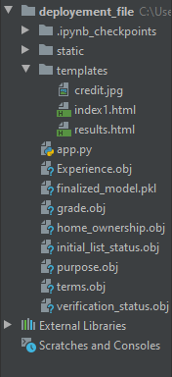
Folder structure of our deployment folder

Slide 14
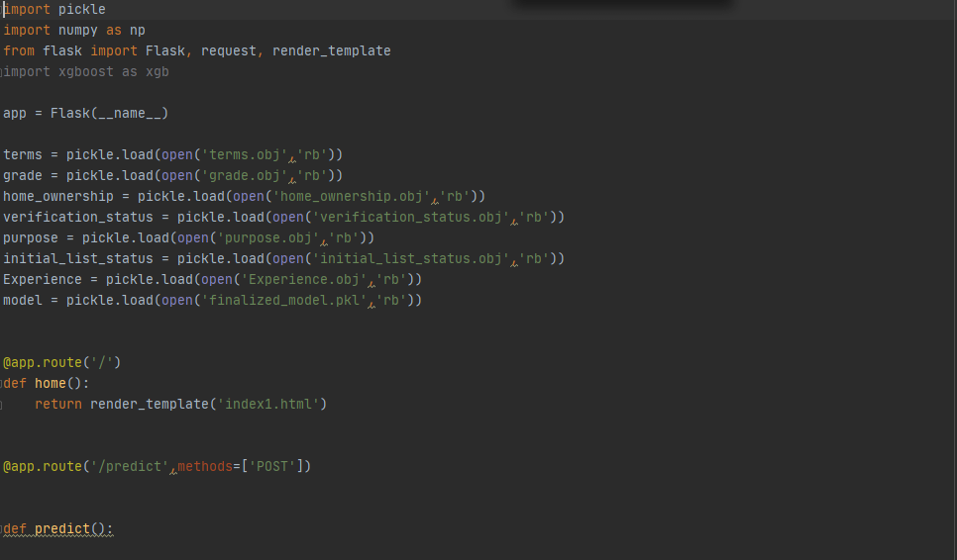
Codes on the pycharm where our app will start from the @app.route(‘/’)

Slide 15
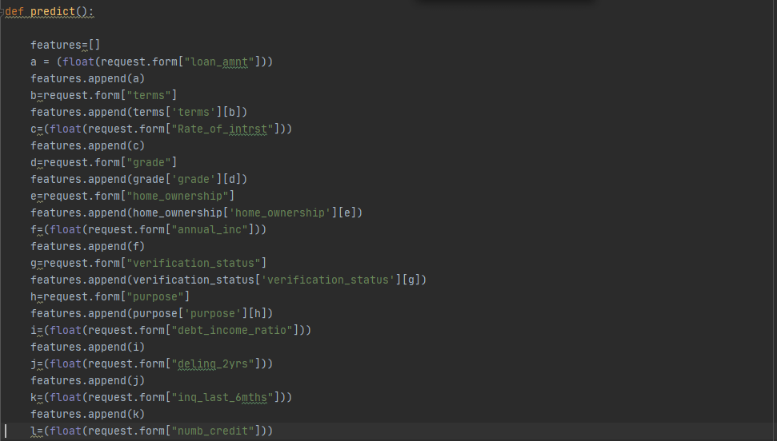
Here , whatever input we r taking from the user interface we are storing in varaibles and storing in array and passing for prediction.

Slide 16
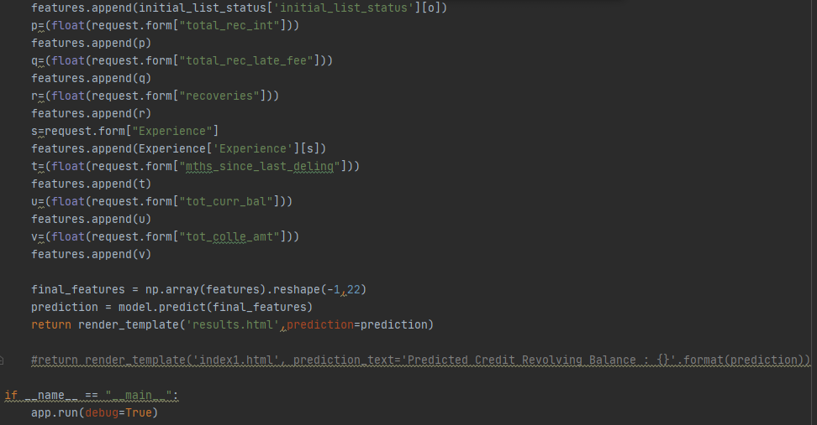
Finaly we r calling here model for predicton and passing our data taken from client in array for prediction. After that catching the predicted value and passing it to the result html page

Slide 17
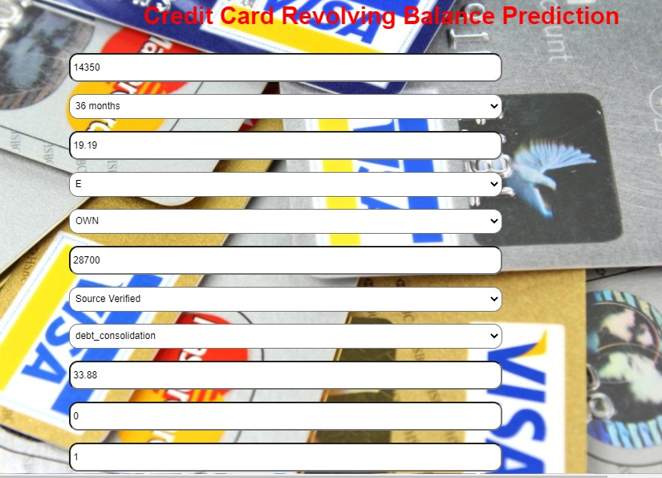
Model Deployment

Slide 18
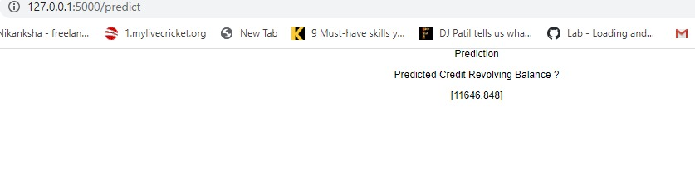
Model Deployment - Prediction

Slide 19
Summary
Out of the 34 columns provided, we deployed a model using 22 columns on the basis of HIGH Feature Importance and RELEVANCE to the prediction.
Clustering was introduced to improve the functionality between the input variables.
“replace” function was used to merge similar kind of variables to reduce the dimensionality.
Frequency Encoding was used to convert categorical values into numeric.
To achieve LOW RMSE and Balanced R-squared values, XGBoost was chosen over Linear Regression, Random Forest and Neural Network models.
Using Flask, we have deployed a web-application which predicts the revolving balance of a user.
Revolving Balance ( here $11646) is the carry-forward balance for the next month, along with the Interest on the remaining balance.

Slide 20
Challenges faced?
Complexity on the volume of data?
Relationship between the variables present in the data?
How to cluster and encode, and not invite the curse of dimensionality?
Achieve a reasonable RMSE and R-squared without over- fitting/under-fitting data?
Deployment of selected model as a web-based application?
How did you overcome?
Complexity on the volume of data? – Understand the terms and exclude variables of less importance.
Relationship between the variables present in the data? - Data Analysis and Visualization techniques helped figure out relationship and enhance prediction.
How to cluster and encode, and not invite the curse of dimensionality? – Used ‘replace’ function to merge variables and then Frequency Encoded to maintain dimensionality.
Achieve a reasonable RMSE and R-squared without over- fitting/under-fitting data?
– Employed various models like Linear Regressor, Random Forest Regressor, XGBoost and Neural Networks to optimize the model selection and its deployment.
Deployment of selected model as a web-based application? – Peer Learning within the team on the implementation of Flask model acquired through past experiences.

Slide 21
Thank you

